Slide 1
Singapore Residents Data Analysis
by Aditya Shukla

Slide 2
About The Data
The data contains Population(Values) by ethnicity, age and gender for the country of Singapore from the year 1957 to 2018.
The Task was to Analyse this data and to showcase the Result.

Slide 3
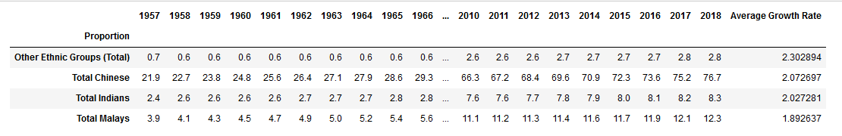
Analysis Based on Ethnic groups in Singapore.
Currently Chinese is largest Ethnic group in Singapore having an Average Growth rate of 2.07%.
Chinese constitutes a total of 76.7% of the total population in Singapore in 2018.
While “Other Ethnic Groups” have a shown a remarkable Average growth rate of 2.3% but they only constitute 2.8% of the total population.
Malays have shown the least Average Growth Rate but constitute 12.3% of the Total Population.

Slide 4
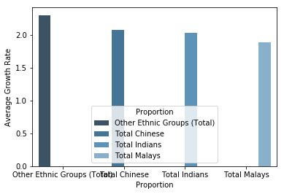
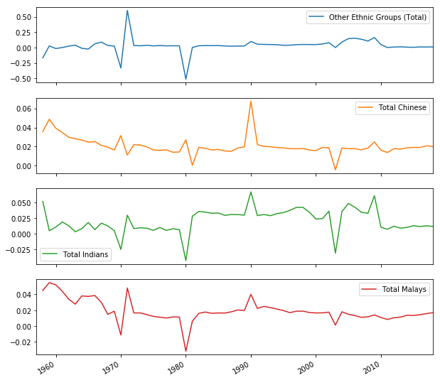
Average Growth Rate and %Change over the Years
The Graph above shows the Average Population Growth of different Ethnic Groups.
The Graph on the left showcase their journey over the years from 1957-2018.

Slide 5
Analysis based on Age groups in Singapore
Proportion | 2018 | Average Growth Rate
0 - 4 Years | 3.6 | -0.581081
10 - 14 Years | 4 | 0.683859
15 - 19 Years | 4.4 | 0.843772
20 - 24 Years | 4.9 | 1.256897
25 - 29 Years | 5.6 | 1.585287
30 - 34 Years | 5.4 | 1.887745
35 - 39 Years | 5.9 | 2.155321
40 - 44 Years | 5.9 | 2.291866
45 - 49 Years | 5.9 | 2.538452
5 - 9 Years | 3.8 | -0.149566
50 - 54 Years | 6 | 2.971074
55 - 59 Years | 5.9 | 3.494326
60 - 64 Years | 5.2 | 4.038713
65 - 69 Years | 4.1 | 4.393379
65 Years & Over | 10.6 | 4.817452
70 - 74 Years | 2.6 | 4.589957
70 Years & Over | 6.5 | 5.153202
75 - 79 Years | 1.8 | 5.204847
75 Years & Over | 3.9 | 5.679302
80 - 84 Years | 1.1 | 5.844546
80 Years & Over | 2.1 | 6.239814
85 Years & Over | 1 | 6.845092

Slide 6
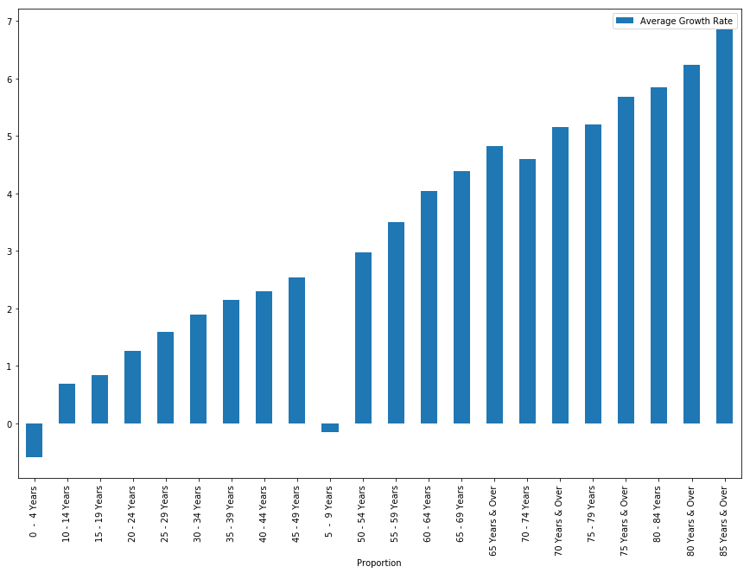
Average Growth Rate and %Change over the Years
Largest Age Group- 65 Years & Over constituting 10.6% of the Total Population with Average Growth Rate of 4.81%.
Smallest Age Group- 85 Years & Over constituting only 1% of the total population with Average Growth Rate of 6.84%.
Highest Average Growth Rate-
85 Years & over-6.84%
Lowest Average Growth Rate-
0 - 4 Years –( -0.58%)

Slide 7
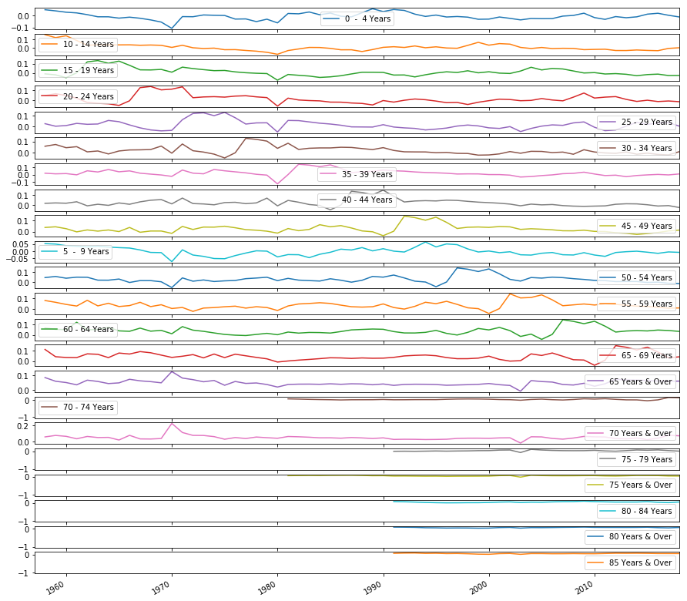
% Change for Age Groups over the Years

Slide 8
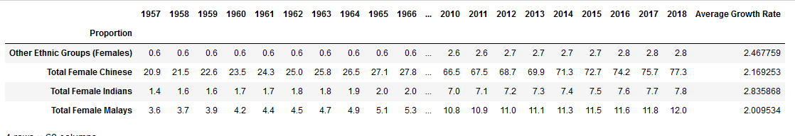
Analysis Based on Female Gender(WRT Female Total Population)
Chinese Female Majority- 77.3% of the total female population with an Average Growth Rate of 2.17%
Other Ethnic Groups Minority- 2.8% of the total female population with an Average Growth Rate of 2.47%
Highest Growth Rate- Indian Female- 2.8%
Lowest Growth Rate Malay Females – 2%

Slide 9
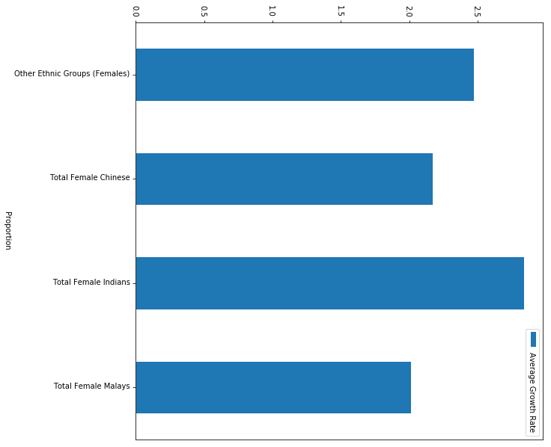
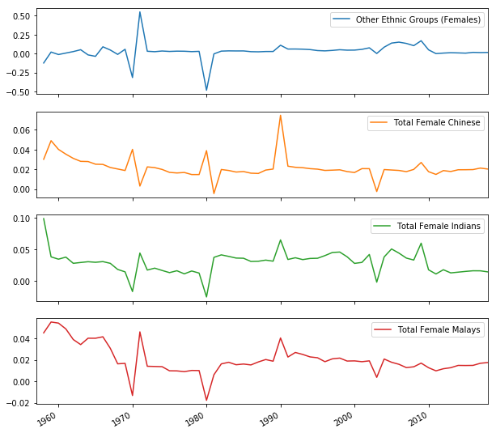
Average Growth Rate and %change
Above Graph- Average growth Rate
Left Graph Percentage Change

Slide 10
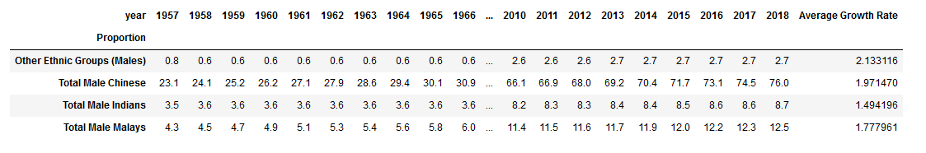
Analysis Based on Male Gender(WRT Male Total Population)
Majority- Chinese Male 76% of the Total Male Population with Average Growth Rate 1.97%.
Minority- Other Ethnic Group – 2.13% of the total Male Population with Average Growth Rate 2.13%.
Highest Growth Rate- Other Ethnic Group 2.13%.
Lowest Growth Rate – Indian Male – 1.49%.

Slide 11
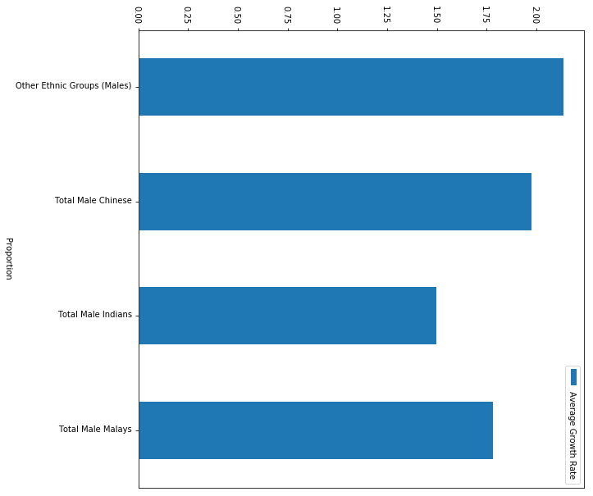
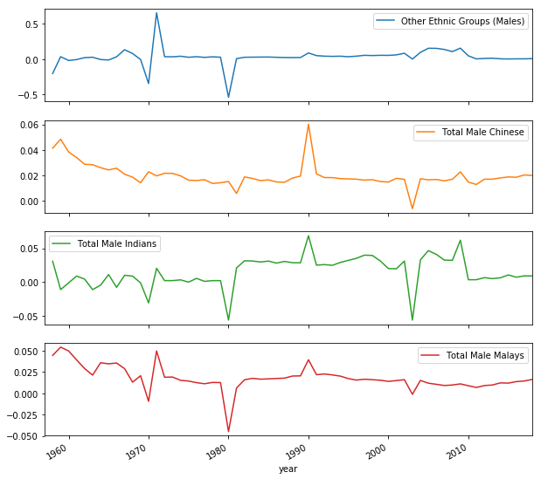
Average Growth Rate and % Change
Above Graph Average Growth Rate.
Left Graph - % change of the male Population over the Years.

Slide 12
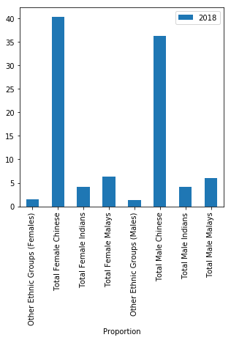
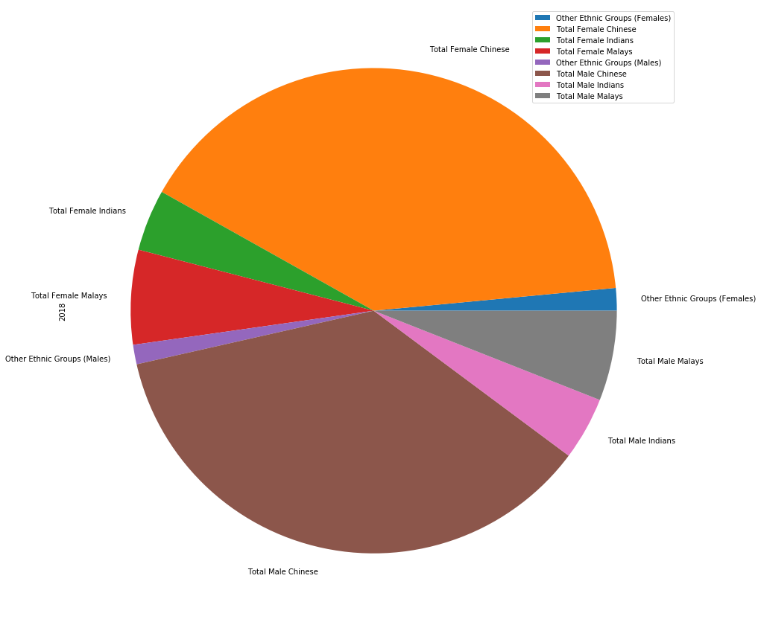
Analysis Based on Gender WRT Total Population
Top 3 (Majority):-
Chinese Females- 40.4%
Chinese Males- 36.3%
Female Malays- 6.3%
Bottom 3 (Minority):-
Other Ethnic Group Male- 1.3%
Other Ethnic Group Female- 1.5%
Female Indian- 4.1%

Slide 13
Thank You

